Slide 1
Economic Growth vs Sustainable Development

Slide 2
Objective
To find suitable parameters which contribute to a country’s development using the data from the last 15 years.
Deduce the reasons why some countries have achieved sustainable development while others have not and what can be done in these countries to achieve sustainable development.

Slide 3
Methodology
Guessing the factors that may be linked to sustainable development
1
Plotting data and proposing equations based on the data.
2
Making a hypothesis and verifying it with the data.
3
Using Kuznets Curve test to find out whether correlation exists or not.
4

Slide 4
Data Gathering and sources
Data has been gathered from respectable sources
World Bank national accounts data
OCED national accounts data
Oak Ridge National Laboratory
World Health Organization.
Check the collected Data

Slide 5
Meta Data
GDP: GDP at purchaser's prices is the sum of gross value added by all resident producers in the economy
Carbon dioxide emissions: Carbon dioxide emissions are those stemming from the burning of fossil fuels and the manufacture of cement.
Natural resource depletion: Natural resource depletion is the sum of net forest depletion, energy depletion, and mineral depletion.
Health expenditure: Public health expenditure consists of recurrent and capital spending from government budgets, external borrowings and grants, and social health insurance.
Agriculture Contribution: Agriculture corresponds to ISIC divisions 1-5 and includes forestry, hunting, and fishing, as well as cultivation of crops and livestock production.
Check full description of Meta Data

Slide 6
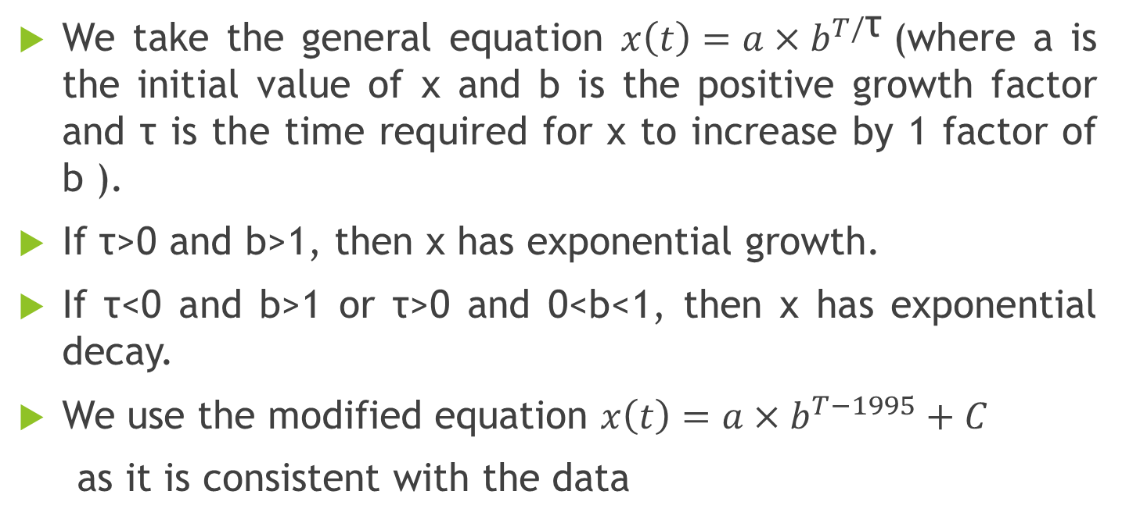
Mathematical Modelling
We take the general equation $x\left(t\right)=a×b^{T/\text{τ}}$(where a is the initial value of x and b is the positive growth factor and τ is the time required for x to increase by 1 factor of b ).
If τ>0 and b>1, then x has exponential growth.
If τ<0 and b>1 or τ>0 and 0<b<1, then x has exponential decay.
We use the modified equation $x\left(t\right)=a×b^{T−1995}+C$
as it is consistent with the data

Slide 7
Programming Mathematical Modelling
The programming of the mathematical models is done on Python – a scientific calculation programming language.
First the data was read and used to find the constants in the mathematical model. Once the models were created the data is fitted again to plot the interpretable graphs.
After much modeling and iterations of data fitting we get the most consistent mathematical models(open here). Then the graphs were plotted(open here).
Predictions: Equations could be formed to make various predictions using the mathematical models. YearPredictor was programmed to find the year of GDP goal fulfilment by India PhotoAlbum-Program.pptx

Slide 8
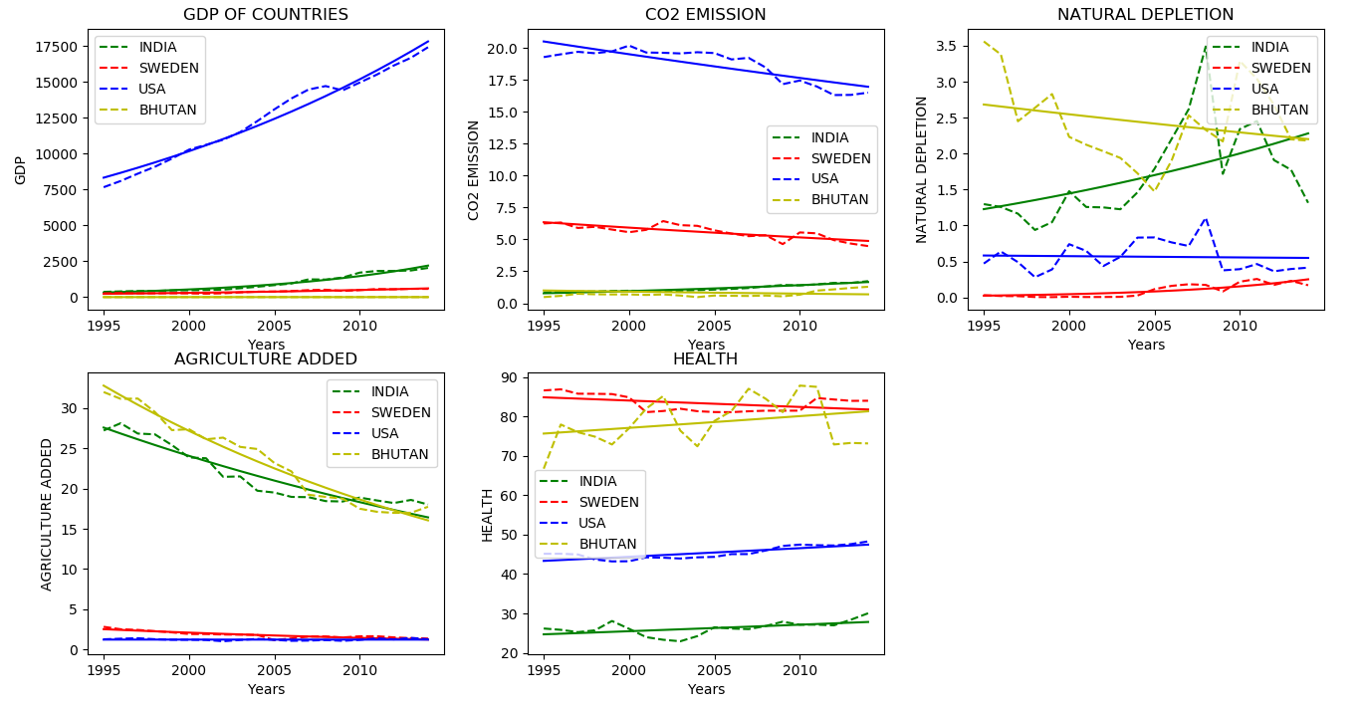
General Function

Slide 9
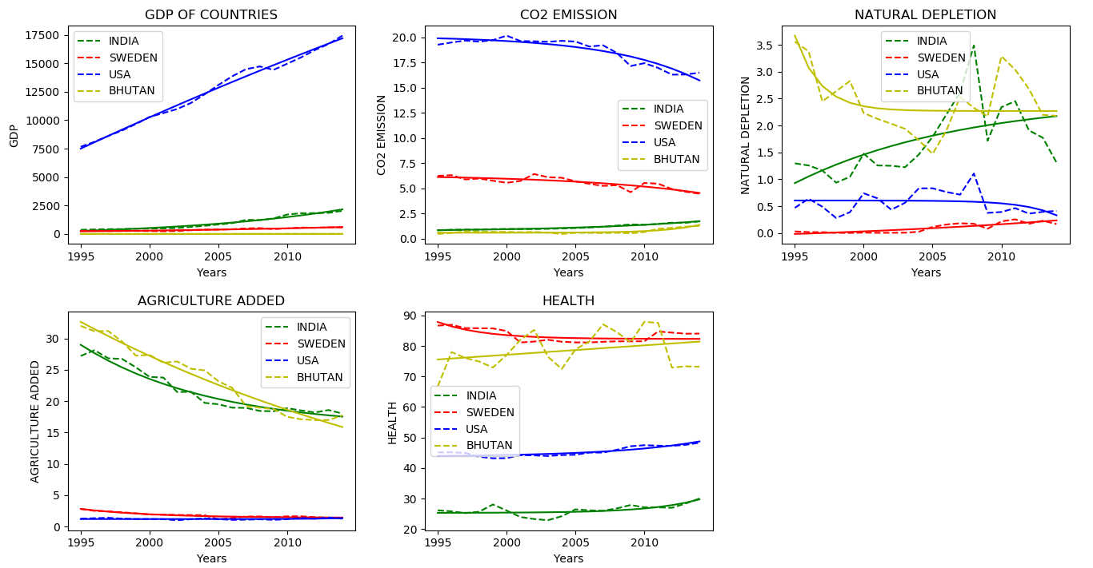
Modified Function

Slide 10
Observations
The Graphs provide evidence that these Policies have led to Sweden attaining Sustainable Development. By having low Natural Depletion and Carbon Dioxide levels, Sweden has reduced the impact on the environment. Paired with the low contribution of Agriculture in GDP, this has led to better utilization of the Natural Resources and Land. The health of the Citizens is also the highest leading to the best utilization of Humans as a Resource.
Though Sweden has low GDP, it has a high Per Capita Income. Moreover, due to being a Socialist Country, Sweden also has achieved optimum Resource equality among its Citizens.

Slide 11
Conclusion
By observing the comparison graphs between the models of indicators of sustainable development we conclude that Sweden is the most sustainably developing country.
By using the Kuznets curve, we can explain this feat. The environmental Kuznets curve suggests that economic development initially leads to deterioration in the environment, but after a certain level of economic growth society begins to improve its relationship with the environment. Check the full analysis of Sweden's policies
We conclude that other countries, using Sweden as an example, should implement policies that will help them achieve sustainable development.

Slide 12
Further Use
The conclusion is one of the many that could be provided using the mathematical models computed. Some of the other uses are:
Prediction: The mathematical models can be used to predict when certain indicator will reach certain point or vice versa.
Analysis: Growth rate and other constants can be analyzed to derive hypothesis and prove them
Conjecture Point: The models can be used to find when countries intersect in any of the indicators.
As the models are made using historical data and hence are subject to change cause of various factors such as governmental policies, natural crisis etc.

Slide 13
Future
Indexing: We can use data to index each country on a sustainable development scale, providing rank to each country on the basis of sustainable development goals achieved.
Machine Learning Model: We can use the data and the mathematical models achieved to make neural network models aiming each country to compute ways to achieve suitable development goals.
Tool Service Provision: We can provide tools to compute the data comparatively to other countries to find sustainable development anomalies and provide where country is lagging behind.

Slide 14
Thank You
By- Amogh Gupta and Arjun Nigam

